Slide 1


Slide 2
GOLD Foundations
Leadership & Beyond
Emerging Leaders Program
Campus Outreach

Slide 3

Outreach Initiatives
Alumni
Speakers
Panels
StrengthsQuest
Community Service

Slide 4
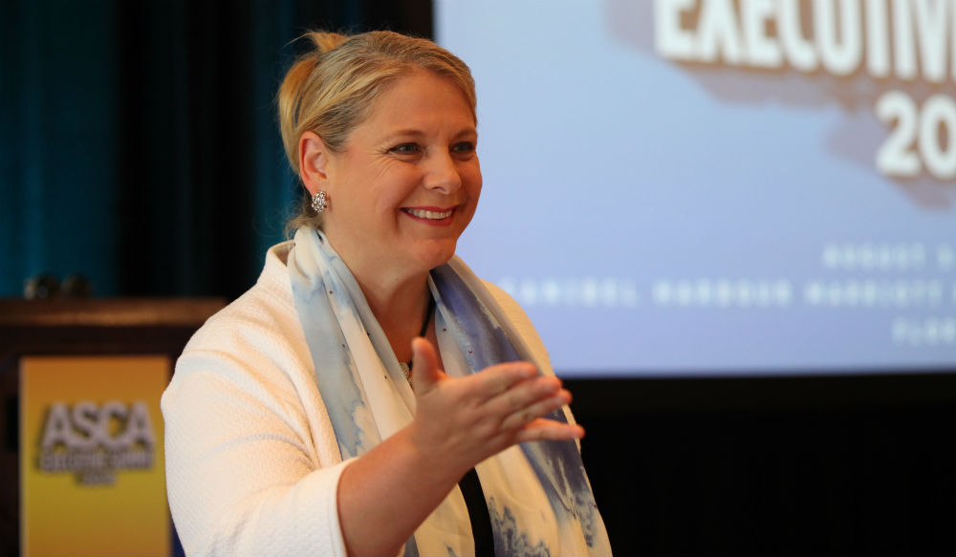



Janine Driver
Body Language Specialist
$33,000 reduced to $1,000
Travel/Accommodations
Key Bridge Marriott: $259
Holiday Inn Rosslyn: $195
The Embassy Row Hotel: $186
DCA-Boston: $117
DCA-New York: $207
DCA-Atlanta: $167

Slide 5

Panels StrengthsQuest Community
Service
Alumni resources
Connecting new students with campus leaders
On and off campus interaction
Other options (CSJ, APO)
Theory
Reflection
Dynamic engagement

Slide 6
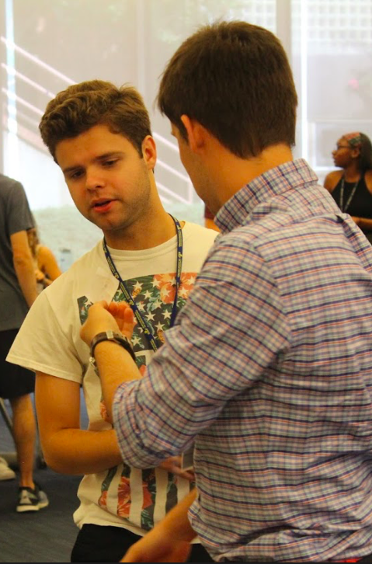
36 participants
1:4
mentor to new student ratio

Slide 7
Signature Programs
Emerging Leaders Program
Adding welcome event
Out-of-classroom experiences and real-life applications
Retreat funding
Leadership & Beyond
Predicted baseline increase of $729.95

Slide 8
Questions

